Slide 1
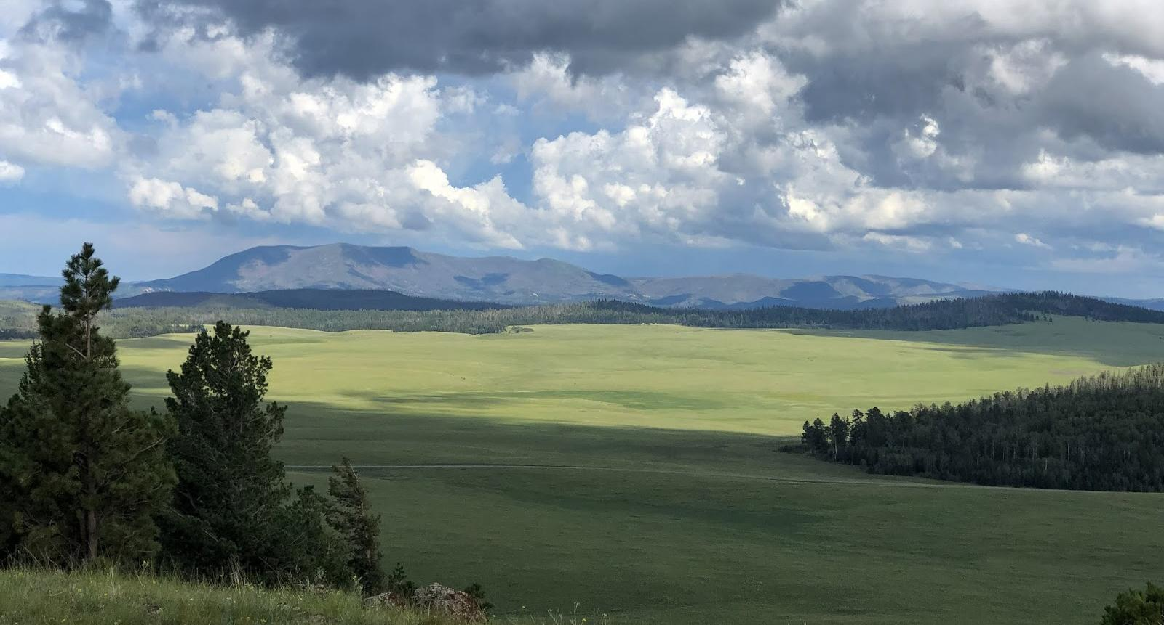
SOTA - What’s This All About?
Christian Claborne, N1CLC - HamNinja.com

Slide 2
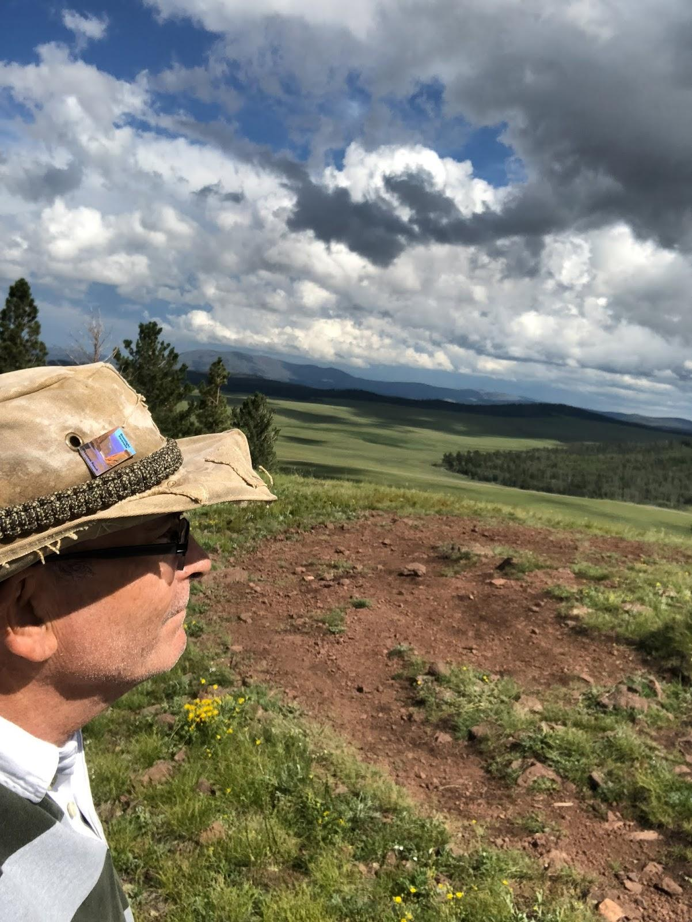
What is SOTA?
Summits on the Air (SOTA) is an award scheme for radio amateurs and shortwave listeners that encourages portable operation in mountainous areas. SOTA has been carefully designed to make participation possible for everyone.
This is not just for mountaineers! It’s not a club, it’s a “do”.
As an “Activator” - You can drive, walk, climb, free solo to a designated summit, get 4 contacts, log them get points.
As a “Chaser” - You contact someone on summit, log it, get points. Find them by going to sotawatch.org and look at “spots”.
It’s Geocaching for radio geeks!

Slide 3
Why chase SOTA (Summits On the Air)
Challenge - thousands sota, low power (if you want), SSB/CW honor system, database for logs, points, awards
Narrow spectrum (watering holes), geography, new friends

Slide 4
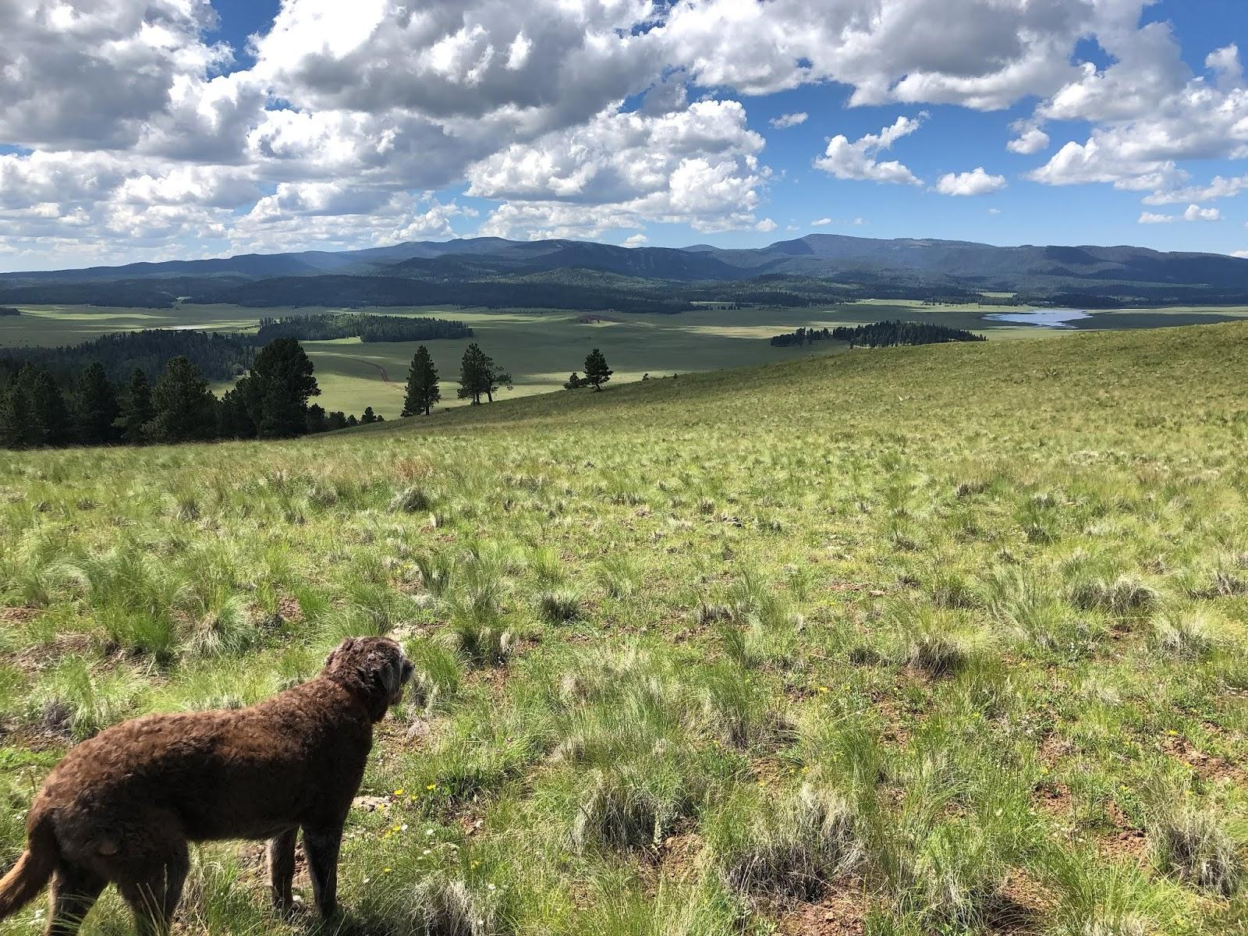
Getting Started
Summits on the Air is an amateur radio awards
scheme. Not a club, no membership etc.
Three primary websites:
SOTA Reflector: https://reflector.sota.org.uk Community forum
SOTA Watch: http://www.sotawatch.org To see who is activating
SOTA Data: http://sotadata.org.uk Where the data is stored
US Specific forum: https://nasota.groups.io/g/main/topics
SOTA - What’s This all About?
By Christian Claborne, N1clc | HamNinja.com
Copyright 2019

Slide 5
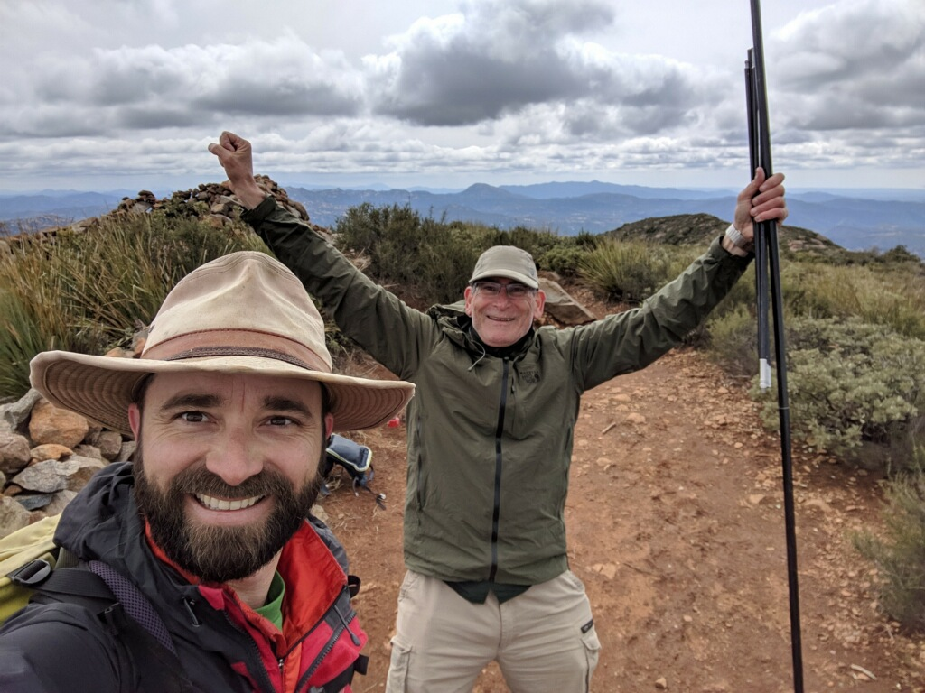
SOTA Lingo
Activator: Ham operator who climbs a summit with gear who makes contacts with other operators not in the current activation zone.
Chaser: Ham operator who looks for operators on a summit.
Association: Geographic area with a specific designation (W6, W7N)
Region: smaller area that is within an association. (W6/SD)
Activation Zone: area that you must be within to qualify the activation (25m, or 82 vertical feet of the summit).
Summit to Summit: Contact made between two activators on two different summits.
SOTA - What’s This all About?
By Christian Claborne, N1clc | HamNinja.com
Copyright 2019

Slide 6
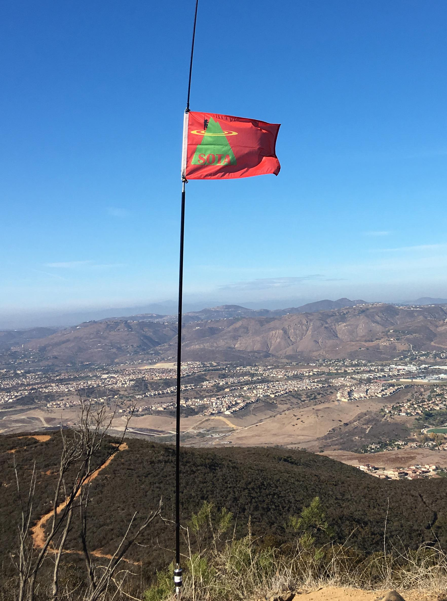
Why Do SOTA?
As an Activator
As a Chaser
Low RF noise, and my antenna is 1000+’ up
Joy of getting outside for some fresh air
The challenge and sense of accomplishment,
Perfect for practicing emcomms for ARES!
Chasing from a mountain top for S2S points
WOW! What a view!
Can’t get out doors so let’s chase
Live vicariously through others adventures
Easy to get contacts
The exchange is always quick and easy
The challenge of pulling out that QRP station
I enjoy hiking and this gives me a reason to work to the top of a mountain. It also pulls me into areas I wouldn’t have thought to explore. This is why do amateur radio!

Slide 7
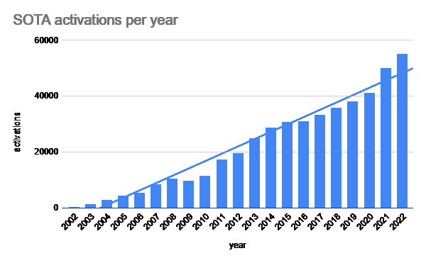
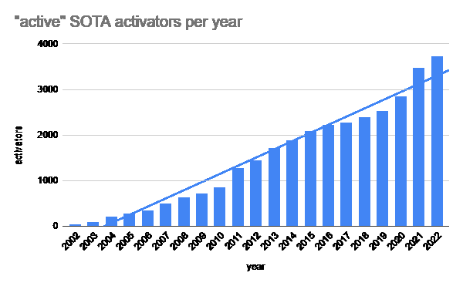
A Few Stats
In summary, SOTA continues to grow!

Slide 8
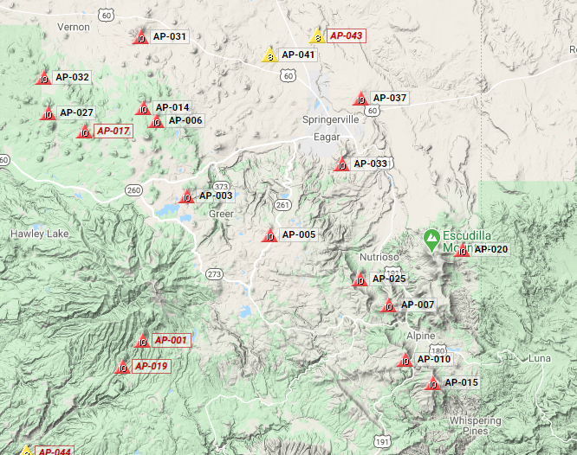
Or Use SOTA Maps To Find A Summit (https:sotamaps.org)

Slide 9
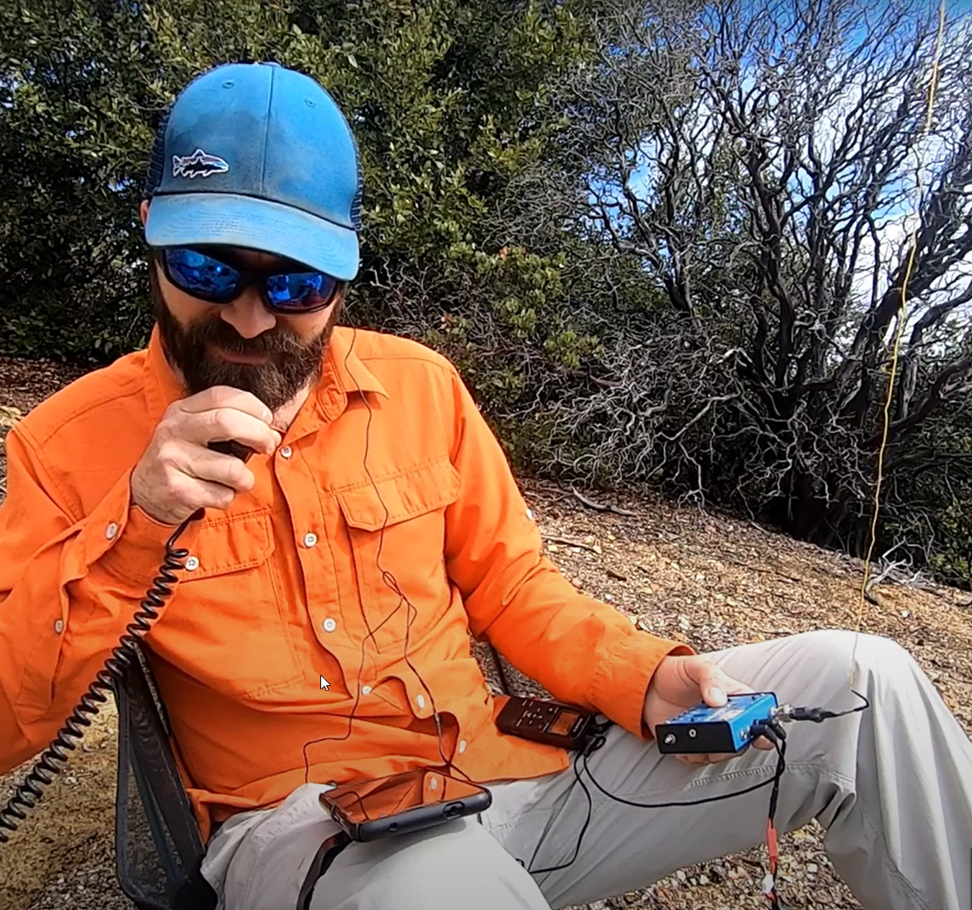
Top Activators Use Two Radios at Once
Adam, K6ARK using his VHF and a Mountain Topper with custom antenna and built-in touch sensitive keyer practicing the art of multitasking. :)

Slide 10
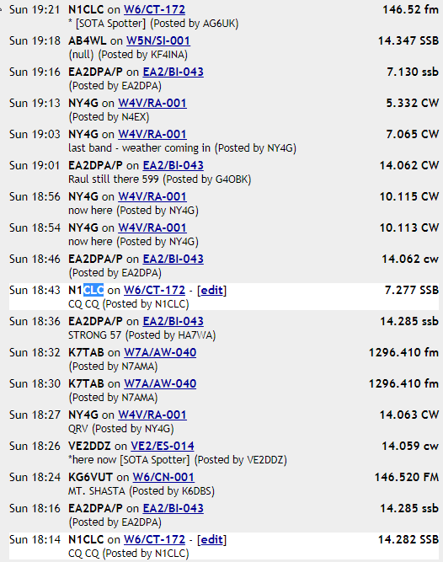
Recipe of an Chaser
sotawatch.org
Fire up your HT, HF, and computer
Monitor SOTAwatch.org/ for “spots” / activators
Tune in and listen, the activator runs the show
Exchange call and signal reports
Log your summit for points at sotadata.org.uk
Look for the next contact
A lot of activators use CW, allowing them to reduce weight. This is a chance to practice (or learn) your CW skills.

Slide 11
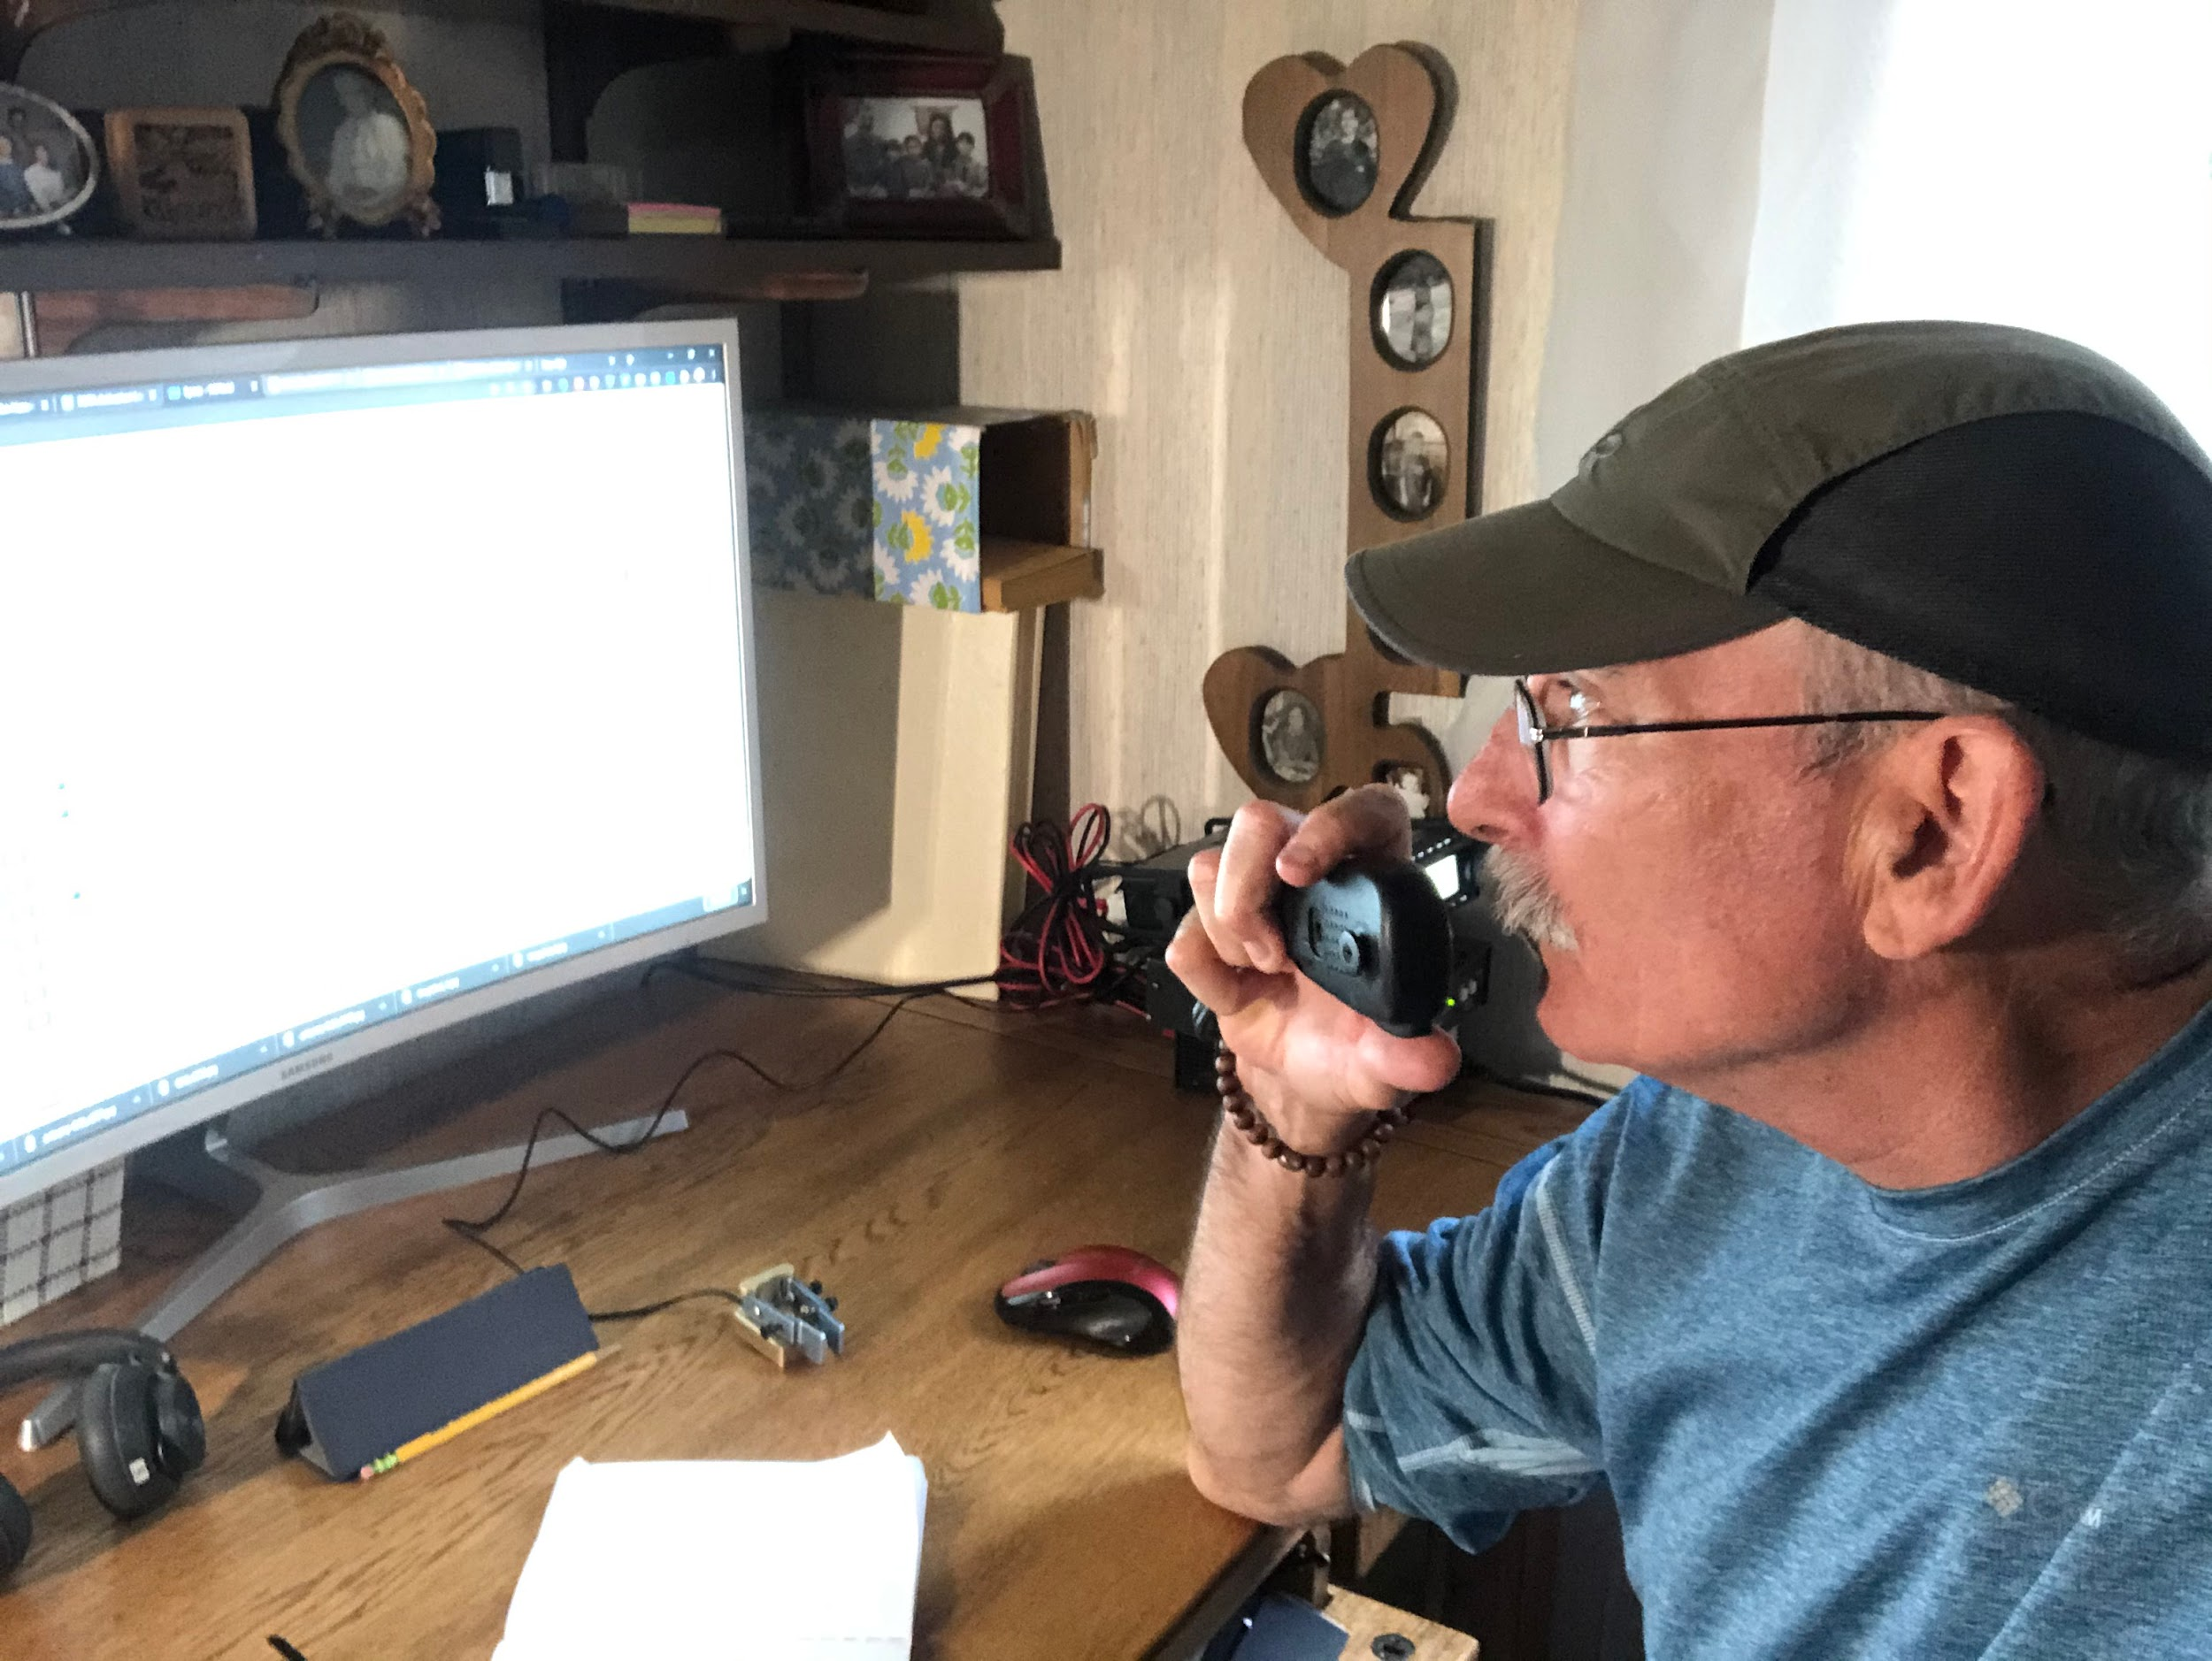
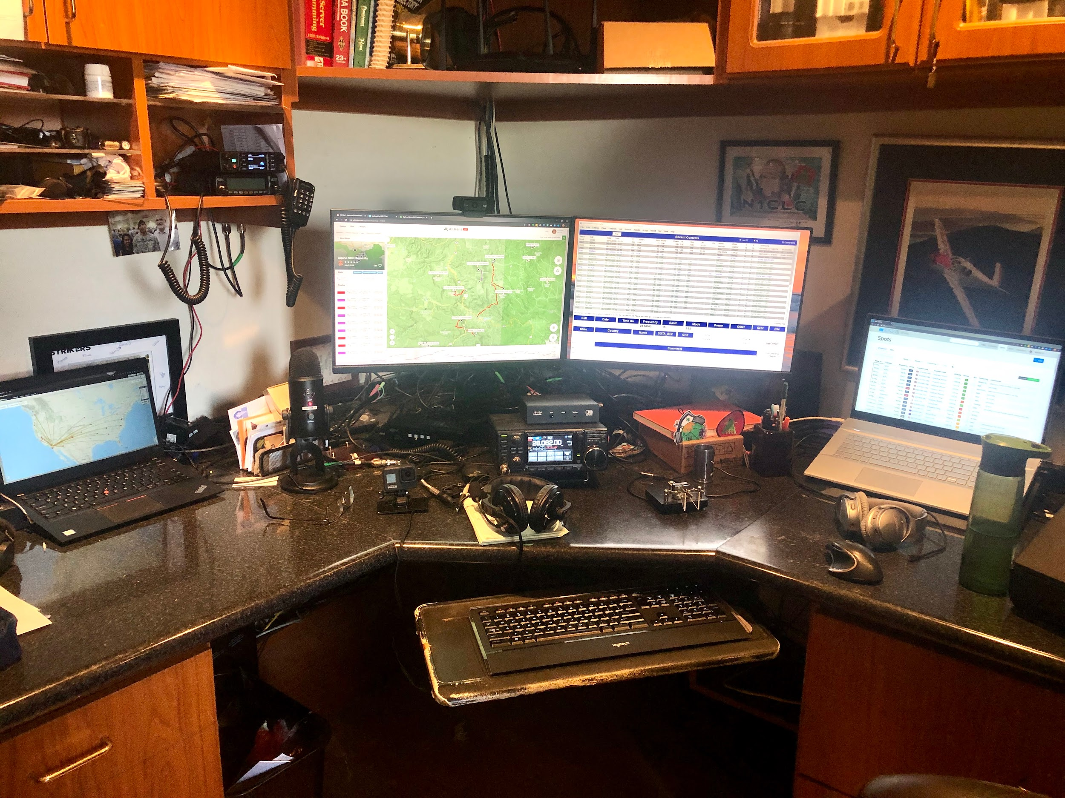
2 - Tune, Listen & Attempt Contact
The activator runs the show. Summit-to-summits get priority. Exchange signal reports to log the contact.
If you can’t hear the activator, 1.21 gigawatts of power isn’t going to help.

Slide 12
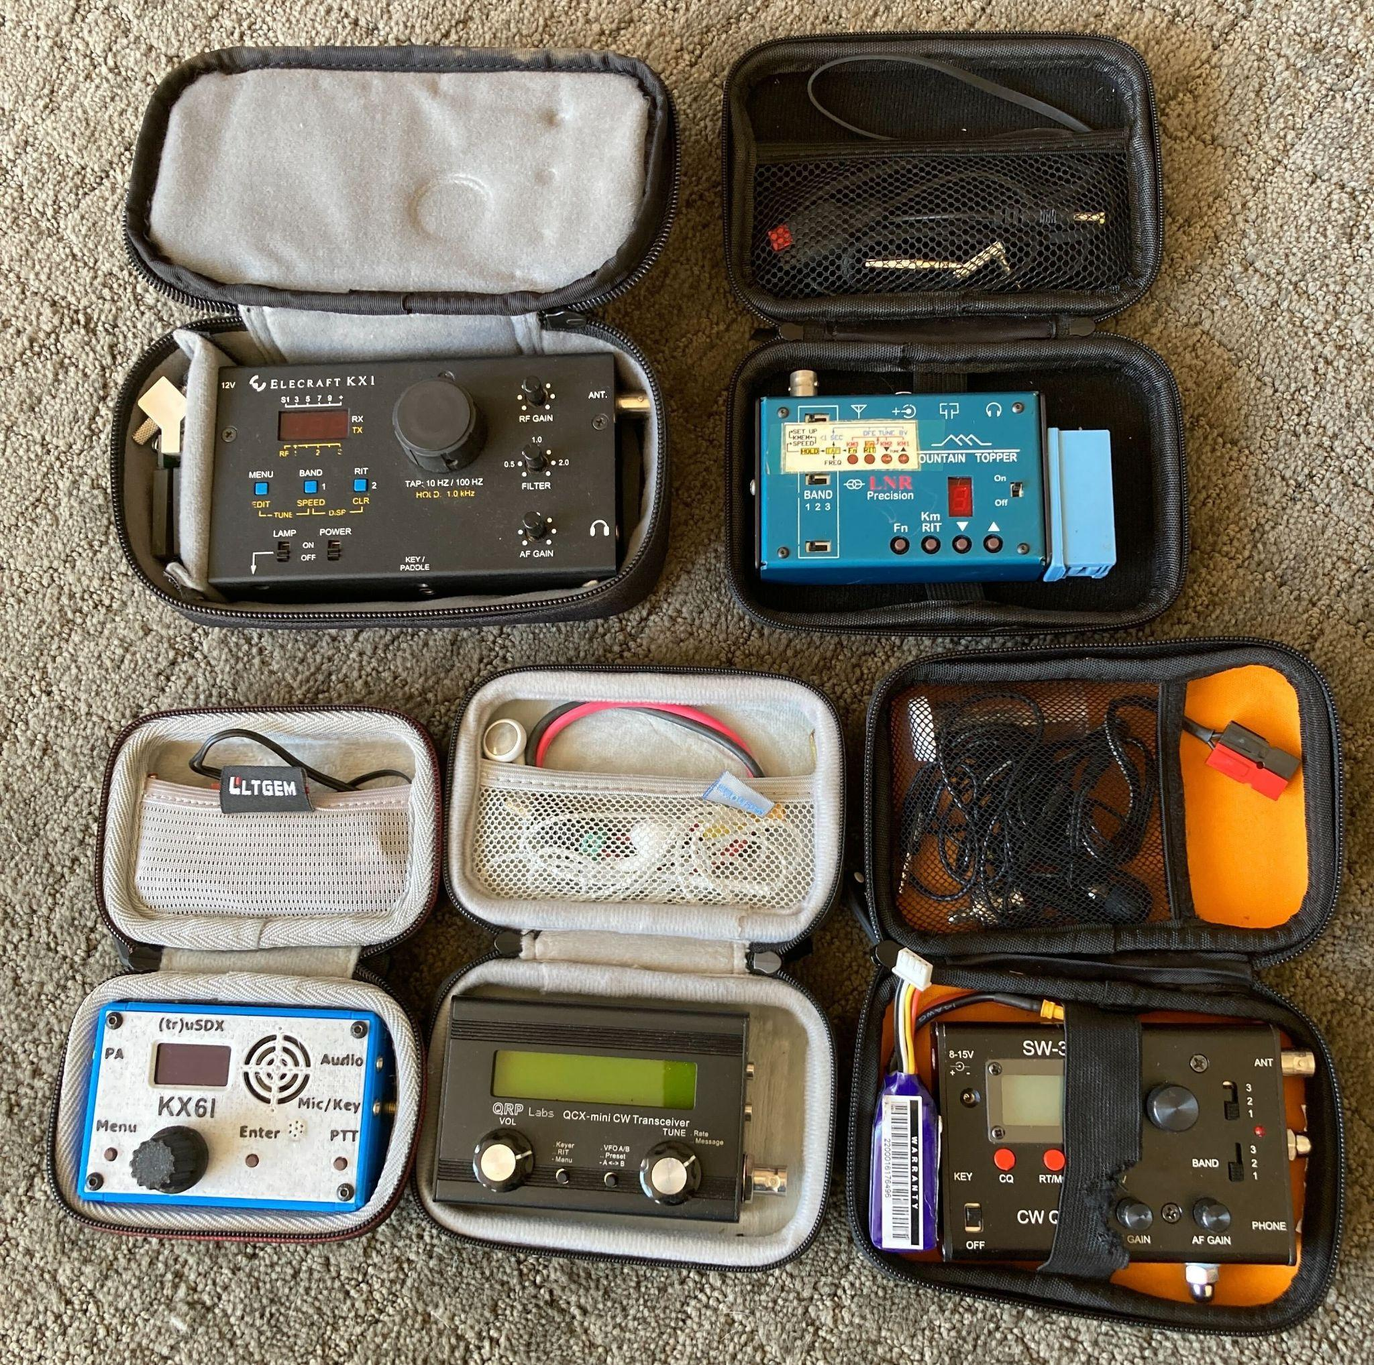
Many Lightweight CW
Options
Elecraft KX1
LNR Mountain Topper
(tr)uSDX
QCX Mini

Slide 13
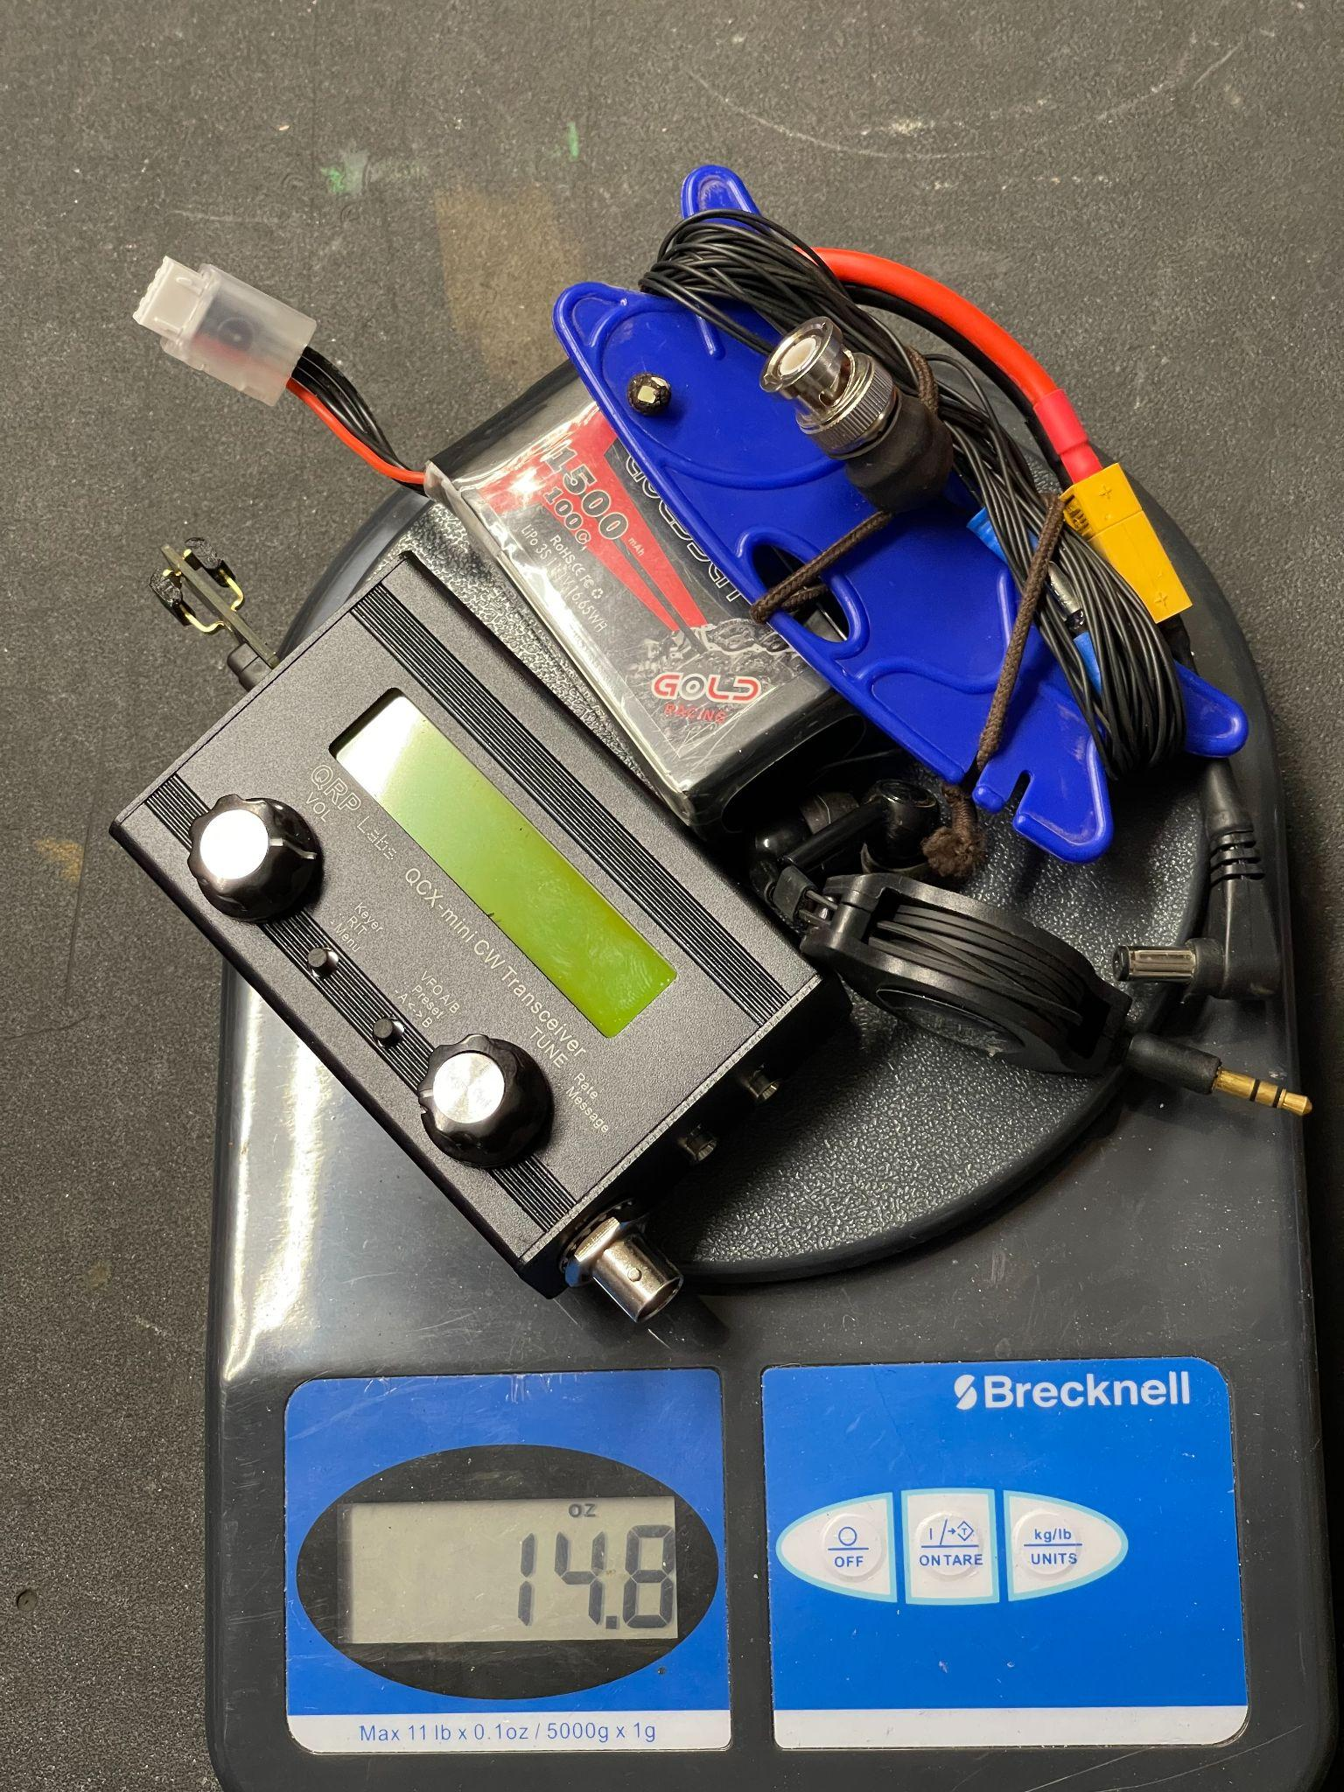
Ham Ninja’s Pocket Portable Station
QCX Mini 20m (4w)
1500 mAh Batt
K6ARK End-Fed Half Wave Antenna
Ear Buds
N6ARA paddles
14.8 oz and work Europe

Slide 14
SPOTA = SOTA + POTA (Why not do both together?)
SOTA
Most require a little bit of hiking.
Most don’t require any sort of entry fee.
Can’t use any part of your vehicle as part of your station.
QRO is heavy :(
Points based on elevation and region.
Must be within 80 vertical feet of the summit.
POTA
Easy access using your vehicle.
Many parks require some sort of fee or pass.
Operate right out of your vehicle, great for foul weather.
Weight is not an issue, bring it all.
Points are simple, one point per park.
Must be within the park boundary for it to count.

Slide 15
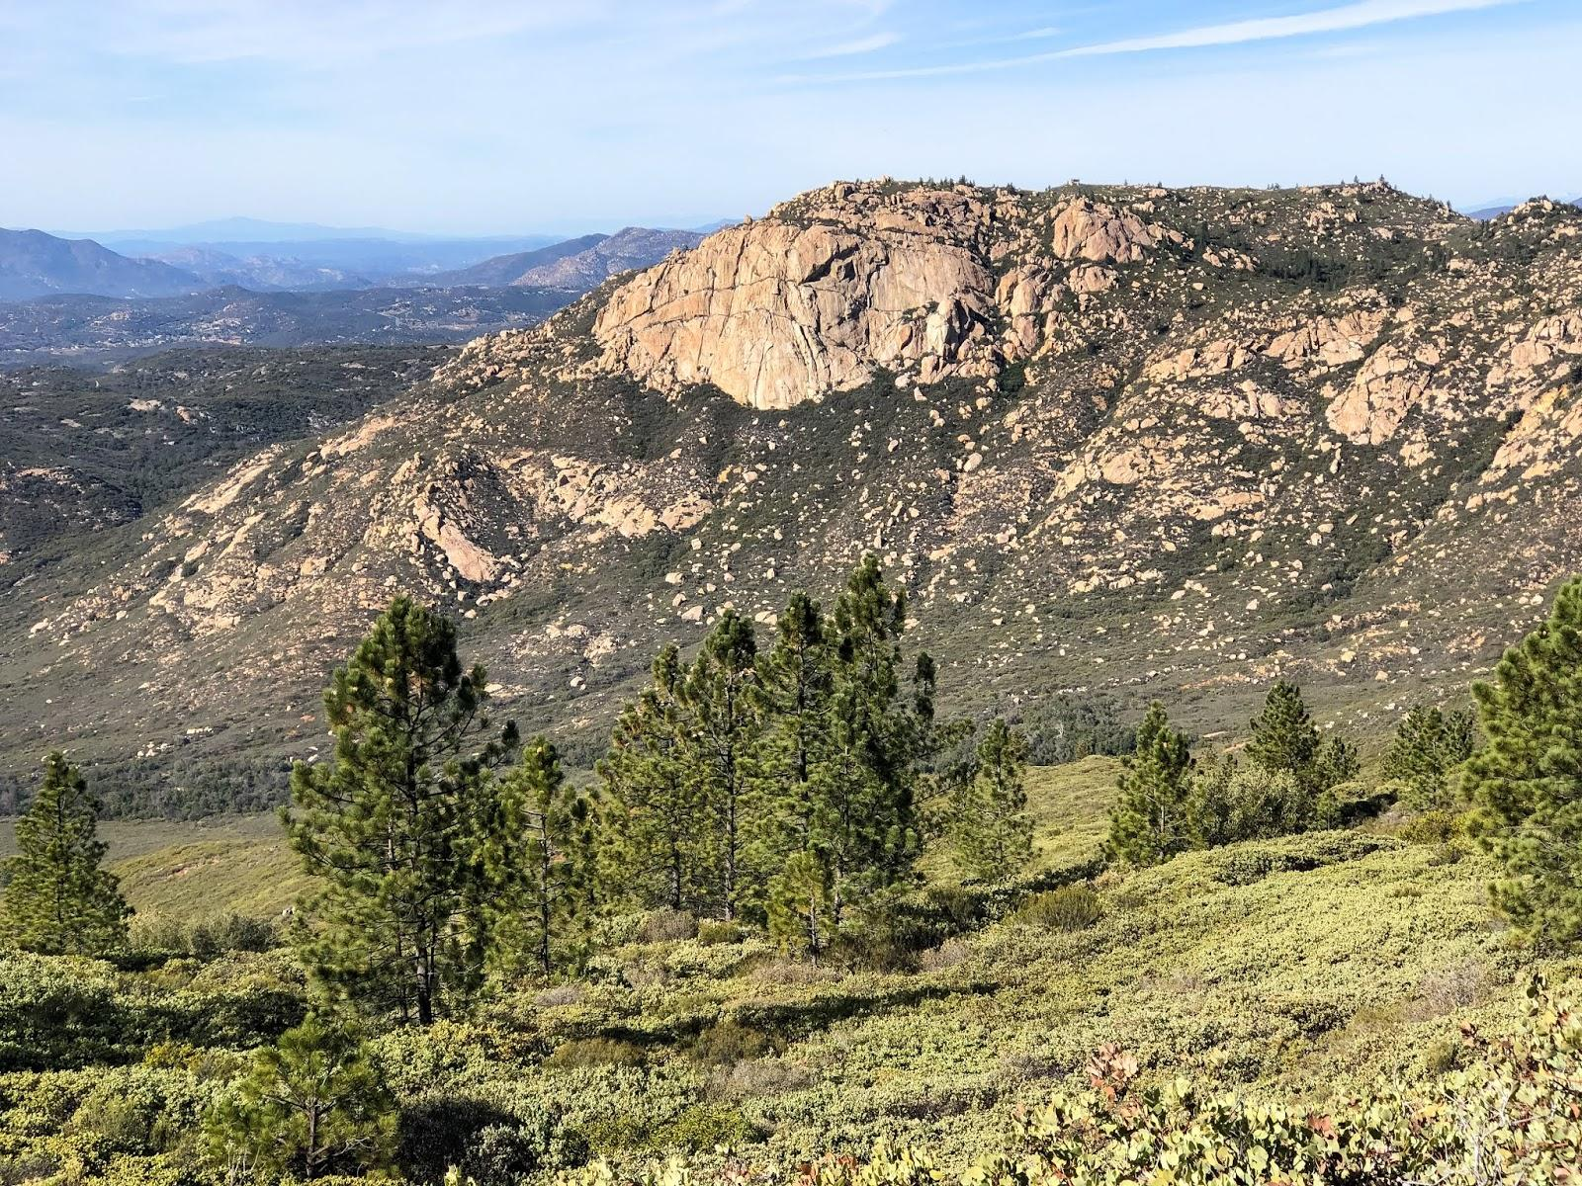
SOTA Award Levels
Shack Sloth: Chaser who reaches 1000 points
Mountain Goat: Activator who reaches 1000 points.
Example of some per state awards:
Bighorn Ram: Individual who has activated 500 points in W6
Golden Eagle: Individual who has chased 500 points of W6 Activations
Nevada Mountain Goat : Custom SOTA flag for Nevada awarded for 25 valid (4 contacts or more) from a SOTA-qualified Nevada peak.
Nevada Beaver Chaser : Custom SOTA flag for Nevada awarded for 250 Chaser points with a SOTA-qualified Nevada peak.

Slide 16
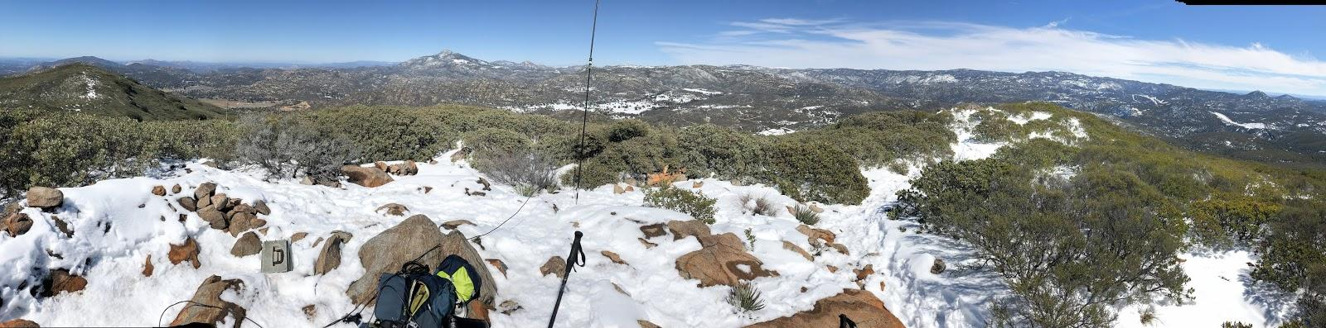
Reference Sites
Sota.org.uk - SOTA Home
Sotadata.org.uk - SOTA info on summits, activator and chaser points, etc (record your data here)
Sotawatch.org - SOTA Alerts and Spotting page. This is how you find planned or current activators.
SotaMaps.org - Original mapping tool
SotaLAS - An awesome sota mapping tool.
Checkout youtube channels for WG0AT, K6ARK, KG6HQD, N1CLC, OH8STN for more expertise
SoCal SOTA Mailing List
W6 (California) region website.
Alltrails.com and Gaia GPS mapping apps. I did a review of them HERE.
Hamninja.com/presentation - This presentation
Hamninja.com/safety - Article on how I prep to mitigate risk.
AZSOTA@groups.io ; Monday & Thursday Night Ham Radio Play list on YouTube

Slide 17
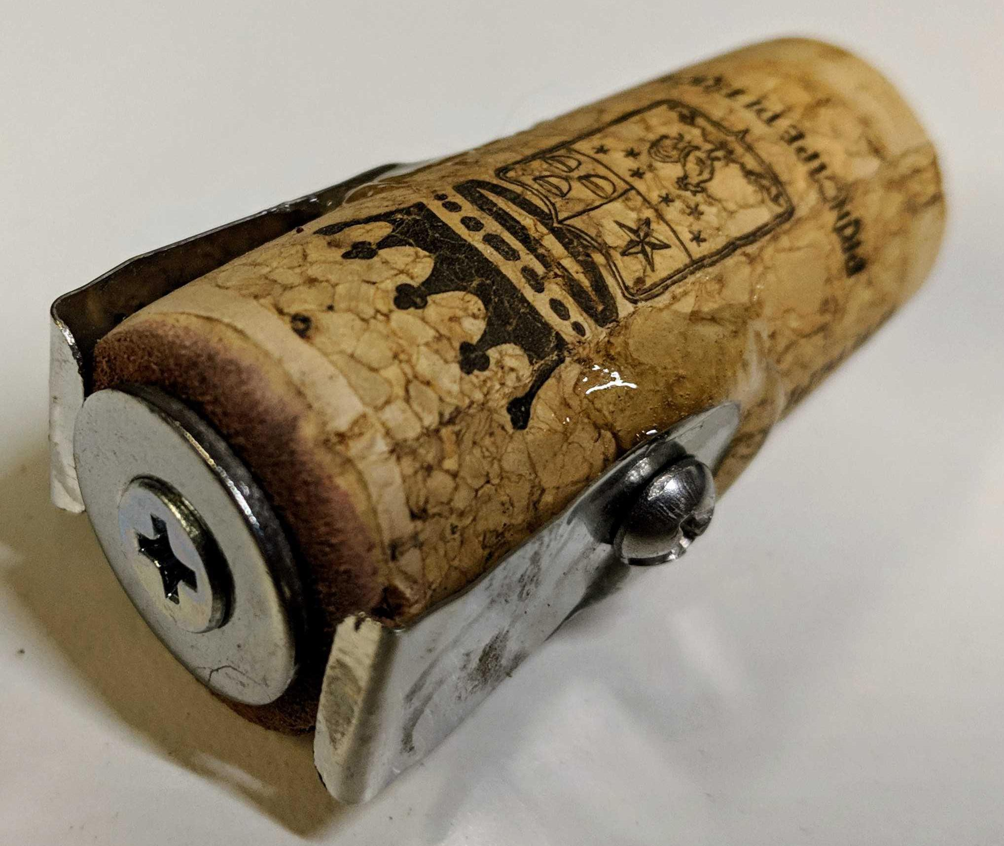
Chris, N1CLC, Top 5 Tips for Learning CW
When practicing your CW copy on a trainer, set the speed to a point that is a small challenge but you still have success.
Observe how you learn, it’s the success that keeps you going & be patient.
Cut & paste a set of call signs that you would most likely get into a CW translation app and practice with those, increase speed slowly. (see hamninja.com/cwpractice)
Chase SOTA stations, it’s low risk, they are patient, and the exchange is super simple. Send call, receive call & RST, send “UR 5NN”. Get some success.
Stick with the Farnsworth method (you learn patterns and rhythm, not dots and dashes)
Have fun and don’t be afraid to try it. People will slow down for you.
For more, go to hamninja.com/cw for my writeup.

Slide 18
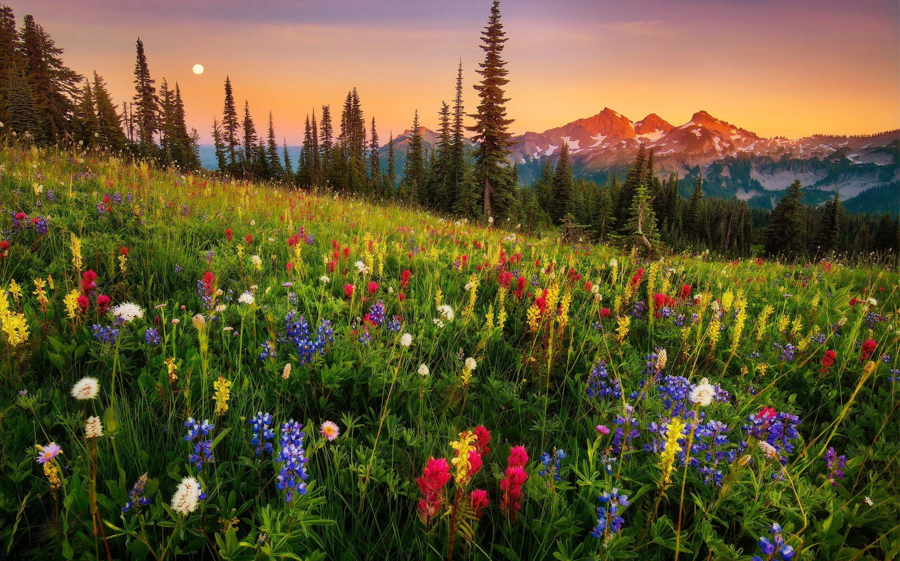
Chaser Roll of Honour
Position | Chaser Callsign | Activators Worked | Points | Average | View Log
1 | NE4TN | 20427 | 111165 | 5.44 | View
2 | N4MJ | 10743 | 61953 | 5.77 | View
3 | KU4R | 10013 | 61408 | 6.13 | View
N4MJ
Chaser Log
Date | Time | Own Callsign | Activator Worked | Summit | Summit Name | Band | Mode | Points | Total | Notes
2024-10-23 | 20:31 | N4MJ | AE7I | W6/NS-185 | Grizzly Mountain | 21MHz | CW | 8 | 8 | 579
2024-10-23 | 17:06 | N4MJ | AC1Z | W1/HA-180 | Gordon Hill | 28MHz | CW | 1 | 9 | 599
2024-10-23 | 16:59 | N4MJ | N0DNF | W7I/SI-186 | Moonlight Mountain | 24MHz | CW | 4 | 13 | 579

Slide 19
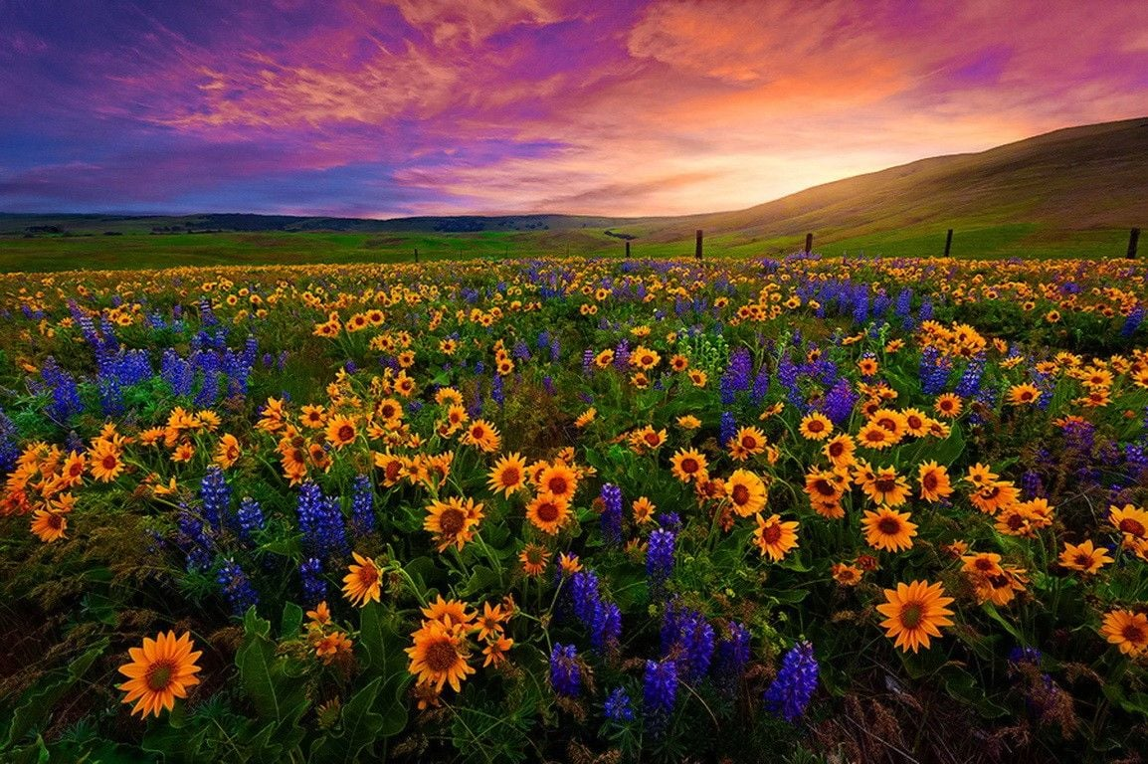
10m Challenge Chaser Results
Position | Callsign | Unique Contacts | Unique Summits | Points
1 | N4MJ | 308 | 606 | 186648
2 | NE4TN | 258 | 544 | 140352
3 | WD4CFN | 53 | 80 | 4240

